Slide 1

Topic:
A simplified app for assessment of reading and writing difficulties in persons with Specific Learning Disabilities
Project Guide : Dr. Raj Kumar
Project id: PCS25-47
BY-
Aayush Kumar Shrivastava (2100290120003) 7A
Abhishek Verma (2100290120009) 7A
Archit Goel (2100290120045) 7A
Kartik Verma (2100290120093) 7B

Slide 2
Project Abstract
Overview
Key Objectives
Approach
This project is aimed to predict likelihood of Dyslexia/Dysgraphia (reading & writing disabilities in persons with Specific Learning Disabilities)
Reading and writing disabilities, such as dyslexia and dysgraphia, hinder individuals' abilities to acquire and use literacy skills effectively. These challenges impact academic performance and daily functioning. Early identification and targeted interventions are crucial for supporting individuals with these disabilities. Technological advancements, particularly in machine learning, offer promising avenues for improving assessment and intervention strategies. By analyzing language patterns and cognitive processes, researchers aim to develop personalized approaches to address the diverse needs of those with reading and writing disabilities, promoting their academic success and overall well-being.
1. Early Intervention
Utilizing prediction models for early identification and targeted intervention strategies for children with reading and writing disabilities.
2. Personalized Learning
Enhancing evidence-based practices using predictive models to improve the overall efficacy of support programs.
3. Accessible Assessment
One of the main focuses of the project is to have a simple and accessible approach to checking for learning disabilities for anybody teachers, parents or even the individuals themselves.
Problem Identification: Define the need for early detection of dyslexia and dysgraphia.
Data Collection: Gather relevant handwriting and reading data for analysis.
Model Selection: Train and test models (e.g., Logistic Regression, Random Forest) to find the best predictor.
Personalized Analysis: Provide tailored insights and intervention plans.
User-Friendly Platform: Build a web interface for accessibility.
Deployment: Use Docker and MongoDB for scalable, flexible deployment.

Slide 3

Project Goals and Objectives
Early Detection: Enable early identification of dyslexia and dysgraphia to support timely intervention.
Personalized Learning: Provide individualized insights to tailor learning strategies for users based on specific needs.
Accessible Assessment: Create an easy-to-use platform for educators, parents, and individuals to assess reading and writing disabilities.
Accurate Predictions: Use reliable machine learning models to achieve high prediction accuracy for better intervention planning.
Educator Support: Equip educators with data-driven insights to improve teaching approaches for students with learning disabilities.

Slide 4
Alignment with UN Sustainable Development Goals (SDGs)
SDG 3: Good Health and Well-Being
Dyslexia is a common learning disorder that affects individuals' ability to read, write, and spell. By using machine learning algorithms like Random Forest and Decision Trees, the DyslexiLens project aims to provide a tool for early detection and intervention. Early diagnosis can significantly improve the quality of life for individuals with dyslexia, enabling them to receive the appropriate support and resources to thrive academically and socially. This project directly contributes to SDG 3 by promoting mental well-being and supporting individuals with learning disabilities in leading healthier, more fulfilling lives.
SDG 10: Reduced Inequality
Individuals with learning disabilities, such as dyslexia, often face significant barriers to educational success, which can lead to greater social and economic inequalities. DyslexiaLens seeks to reduce these inequalities by providing an accessible, affordable tool for early diagnosis, especially in underprivileged regions where educational resources may be scarce. By making dyslexia detection available to a wider audience, this project empowers individuals, regardless of their socio-economic status, to overcome challenges and access the same educational opportunities as their peers, thus helping to reduce inequality in educational outcomes.

Slide 5
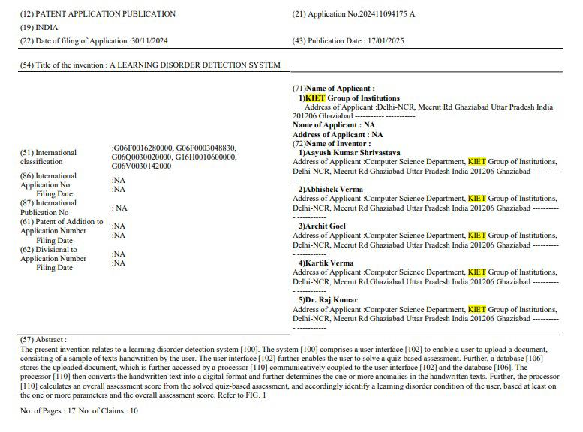
Proof of patent publication (Screenshot of Publication)

Slide 6

Understanding the Impact of Reading & Writing Disabilities
Psychosocial Effects
Supportive Interventions
Understanding the emotional and psychological impact of these disabilities on individuals, emphasizing the importance of a holistic approach to support.
Investigating various intervention strategies to improve literacy skills and enhance the overall quality of life for individuals with disabilities.
Challenges Faced
Exploring the daily struggles individuals face due to reading and writing disabilities, highlighting the impact on learning and confidence.

Slide 7

Methodology and Approach
Data Collection: Collect data on handwriting samples and other literacy indicators for individuals with potential dyslexia or dysgraphia. (Source – Kaggle)
Preprocessing: Clean and preprocess the data, handling missing values and standardizing features.
Model Training: Train machine learning models, such as Decision Tree, and Random Forest, to predict learning disabilities.
Evaluation: Evaluate each model's accuracy using metrics like confusion matrices to identify the most effective predictor.
Platform Development: Build a user-friendly web interface where users can input data and view results, with backend support for model deployment.

Slide 8
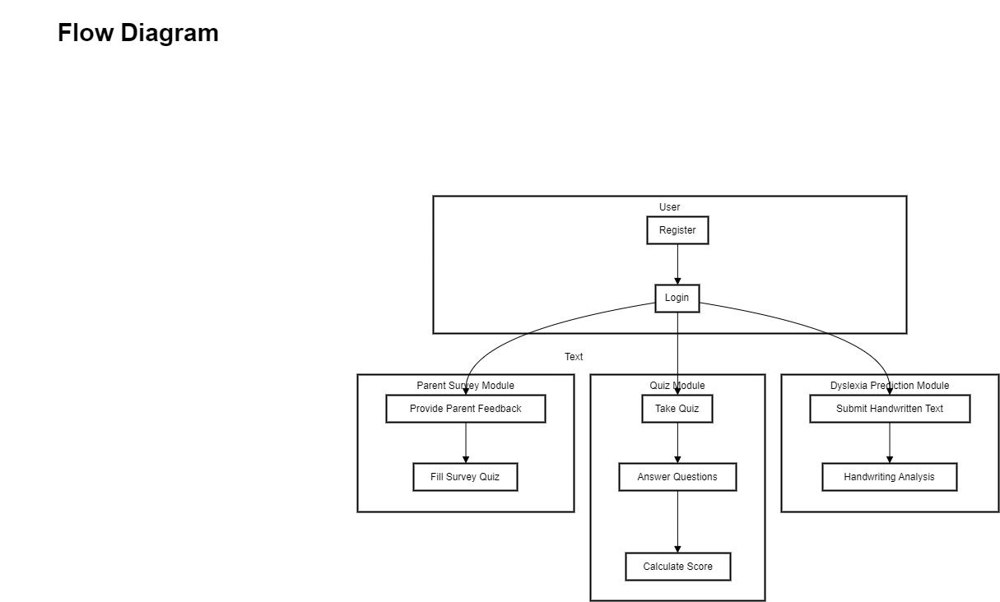
Methodology and Approach

Slide 9
Technologies
1. Programming Languages:
Python: Used for machine learning model development, data preprocessing, and OCR integration.
JavaScript (React.js): Used for the front-end interface of the web application.
HTML, CSS: Used for designing the user interface.
2. Machine Learning Frameworks & Libraries:
Scikit-learn: Used for implementing Decision Tree and Random Forest classifiers.
TensorFlow/Keras: Can be used for deep learning enhancements in future versions.
OpenCV: Used for preprocessing handwriting images before OCR conversion.
NLTK (Natural Language Toolkit): Helps in grammatical analysis and text processing.
3. Optical Character Recognition (OCR):
Tesseract OCR: Converts handwritten text images into machine-readable text.

Slide 10
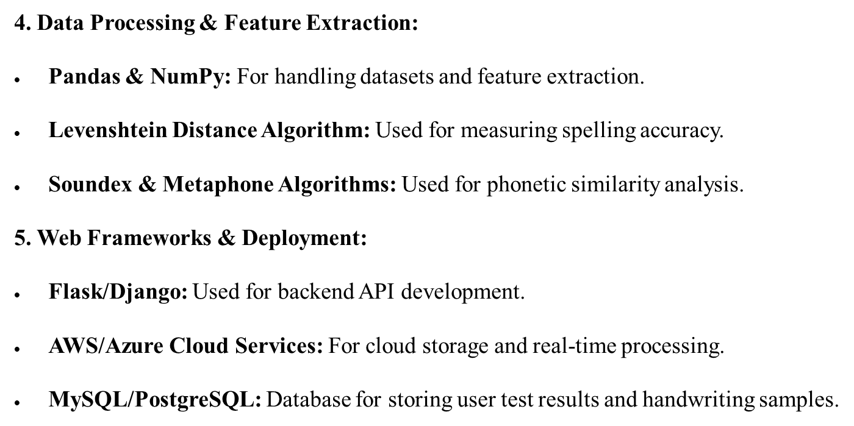
Technologies

Slide 11
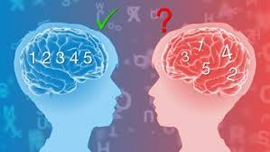
Expected Outcomes and Impact
Accurate Diagnosis: Provide a reliable and accessible tool for the early detection of dyslexia and dysgraphia, leading to improved diagnosis rates.
Personalized Interventions: Enable customized learning plans and interventions tailored to each individual’s needs, enhancing their literacy skills.
Educational Support: Equip educators and parents with actionable insights to better support individuals with learning disabilities.
Increased Awareness: Promote awareness about reading and writing disabilities, encouraging early assessment and reducing stigma.
Long-Term Academic Success: Improve academic outcomes and quality of life for individuals with dyslexia or dysgraphia by addressing learning needs early.
Scalable Solution: Provide a scalable platform that can be expanded to support other learning disabilities in the future.

Slide 12
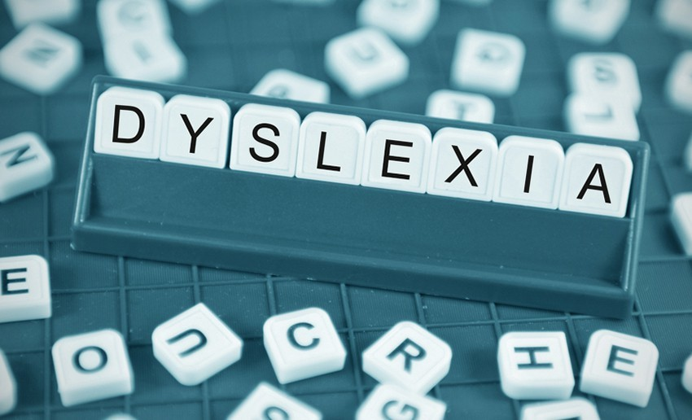
Key Project Deliverables
Data Collection and Preprocessing Module: A structured dataset of handwriting samples and literacy indicators, prepared for machine learning analysis.
Machine Learning Models: Trained and tested models (i.e. Decision Tree, Random Forest) for predicting dyslexia and dysgraphia.
Web Interface: A user-friendly, interactive website where users can enter data and receive assessment results.
Backend Infrastructure: A robust backend setup using Nodejs, integrated with the machine learning models for real-time analysis using flask server.
Database Management: Implementation of a NoSQL database (e.g., MongoDB) to store user data, assessments, and model results securely.
Documentation: Comprehensive documentation of the project, including data sources, model performance, usage instructions, and technical architecture.
Deployment and Testing: A fully deployed and tested web platform accessible to end users, complete with scalability through Docker containerization.
Final Report and Presentation: A report summarizing project methodology, findings, and recommendations, along with a presentation for stakeholders.

Slide 13
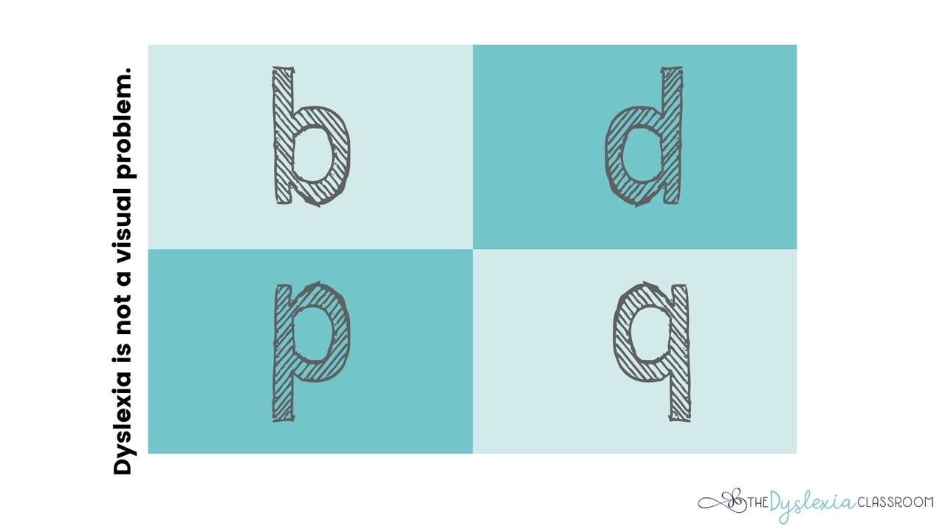
Next Steps and Conclusion
1
Individual Assessments
2
Intervention Planning
Conducting personalized assessments using the model to identify specific areas of difficulty and strength for each individual.
Developing targeted intervention plans based on the model's predictions to improve learning outcomes and literacy skills.
3
Educator Support
Providing educators with valuable insights from the model to enhance teaching strategies and tailor support for students.

